Slide 1
CS217 – Object Oriented Programming (OOP)
Week – 15
May 24-28, 2021
Instructor: Basit Ali

Slide 2
Streams
Stream
A transfer of information in the form of a sequence of bytes
I/O Operations
Input: A stream that flows from an input device ( i.e.: keyboard, disk drive, network connection) to main memory
Output: A stream that flows from main memory to an output device ( i.e.: screen, printer, disk drive, network connection)

Slide 3
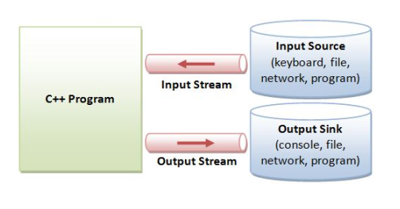

Slide 4
Iostream Library Header Files
iostream library
<iostream.h>: Contains cin & cout objects
<fstream.h>: Contains information important to user-controlled file processing operations

Slide 5
file (fstream)
ifstream - defines new input stream (normally associated with a file).
ofstream - defines new output stream (normally associated with a file).

Slide 6
General File I/O Steps
Include the header file fstream in the program.
Declare file stream variables.
Open the file
Use the file stream variables with >>, <<, or other input/output functions.
Close the file.

Slide 7
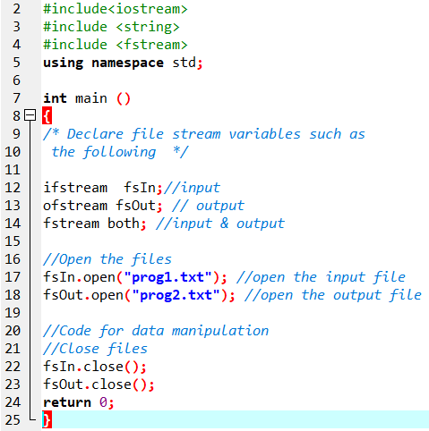

Slide 8
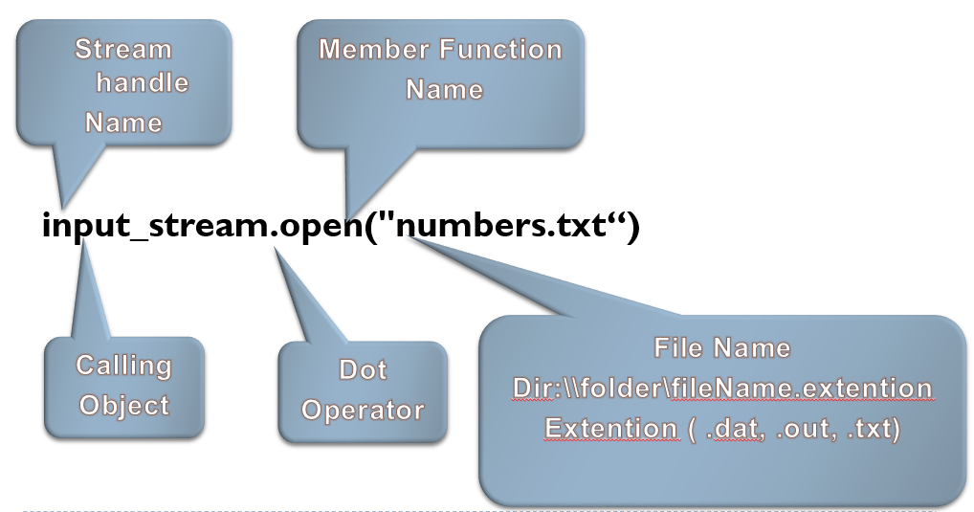
Object and Member Functions

Slide 9
Open()
Opening a file associates a file stream variable declared in the program with a physical file at the source, such as a disk.
In the case of an input file:
the file must exist before the open statement executes.
If the file does not exist, the open statement fails and the input stream enters the fail state
An output file does not have to exist before it is opened;
if the output file does not exist, the computer prepares an empty file for output.
If the designated output file already exists, by default, the old contents are erased when the file is opened.

Slide 10
Validate the file before trying to access
Method 1:
By checking the stream variable;
If ( ! Mystream)
{
Cout << “Cannot open file.\n ”;
}
Method 2:
By using bool is_open() function.
If ( ! Mystream.is_open()) {
Cout << “File is not open.\n ”;
}

Slide 11
Input File-Related Functions
fsin.get(char character)
extracts next character from the input stream fsin and places it in the character variable character.
fsin.eof()
tests for the end-of-file condition.

Slide 12
File I/O Example: Reading
Read char by char
Read a line
#include <iostream>
#include <fstream>
int main()
{//Declare and open a text file
ifstream openFile(“data.txt");
char ch;
//do until the end of file
while( ! OpenFile.eof() )
{
OpenFile.get(ch); // get one character
cout << ch; // display the character
}
OpenFile.close(); // close the file
return 0;
}
#include <iostream>
#include <fstream>
#include <string>
int main()
{//Declare and open a text file
ifstream openFile("data.txt");
string line;
while(!openFile.eof())
{//fetch line from data.txt and put it in a string
getline(openFile, line);
cout << line;
}
openFile.close(); // close the file
return 0; }

Slide 13
Output File-Related Functions
ofstream fsOut;
fsOut.open(const char[] fname)
connects stream fsOut to the external file fname.
fsOut.put(char character)
inserts character character to the output stream fsOut.
fsOut.eof()
tests for the end-of-file condition.

Slide 14
File I/O Example: Writing
First Method (use the constructor)
Second Method ( use Open function)
#include <fstream>
using namespace std;
int main()
{/* declare and automatically open the file*/
ofstream outFile("fout.txt");
//behave just like cout, put the word into the file
outFile << "Hello World!";
outFile.close();
return 0;
}
#include <fstream>
using namespace std;
int main()
{// declare output file variable
ofstream outFile;
// open an exist file fout.txt
outFile.open("fout.txt”);
//behave just like cout, put the word into the file
outFile << "Hello World!";
outFile.close();
return 0;
}

Slide 15
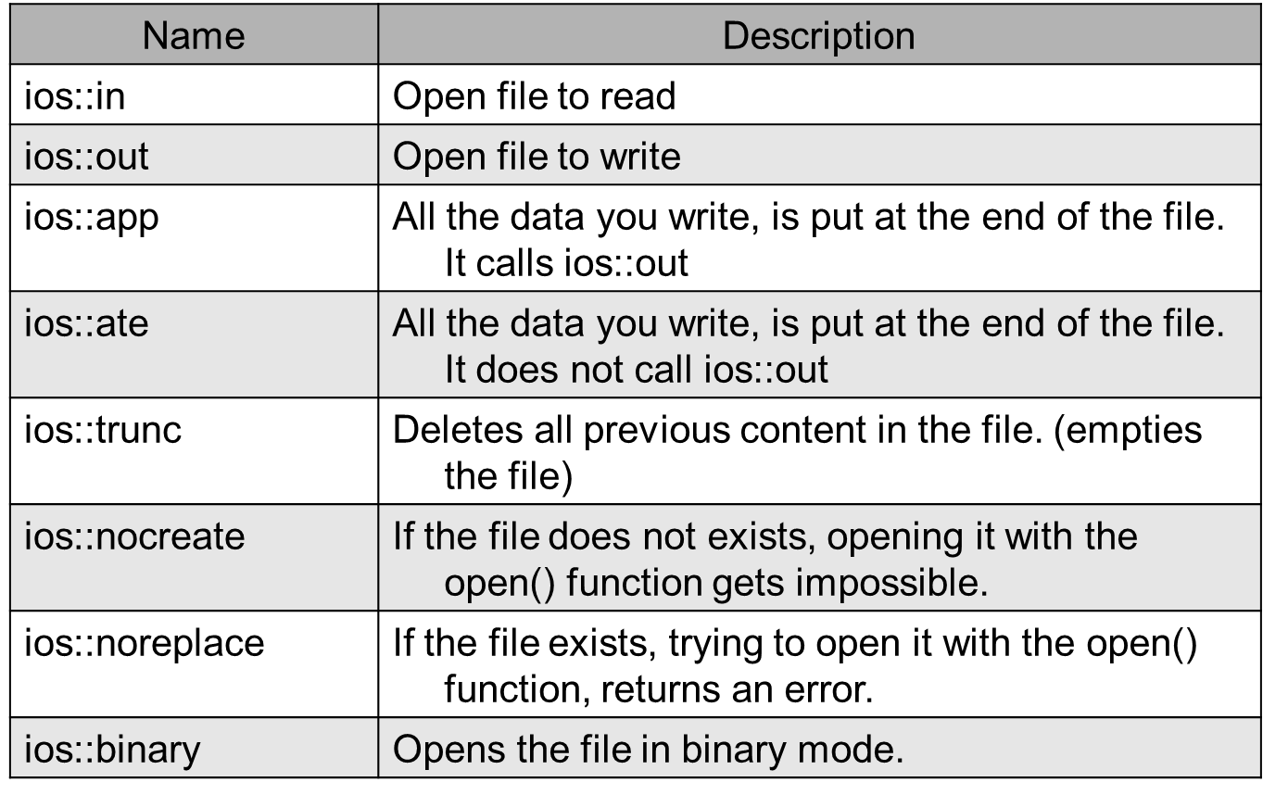
File Open Mode

Slide 16
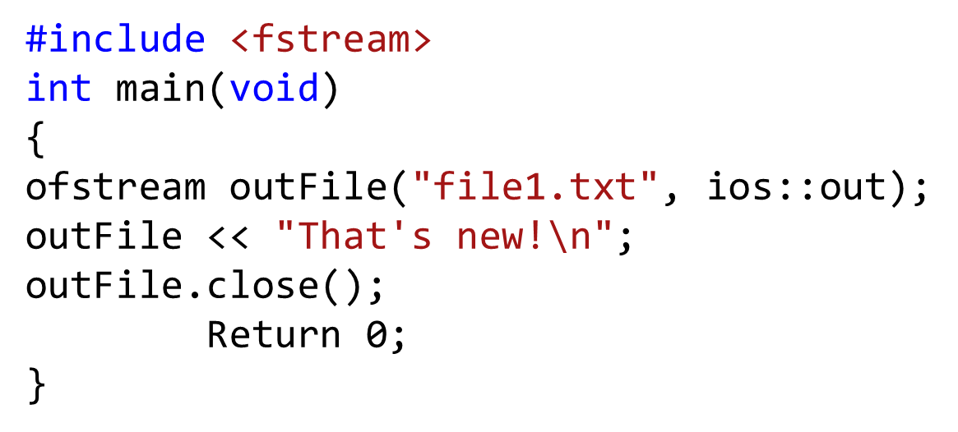
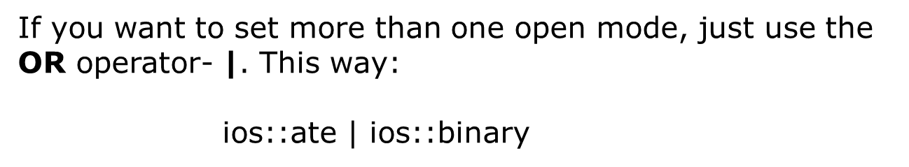
File Open Mode

Slide 17
File format
In c++ files we (read from/ write to) them as a stream of characters
What if I want to write or read numbers ?

Slide 18
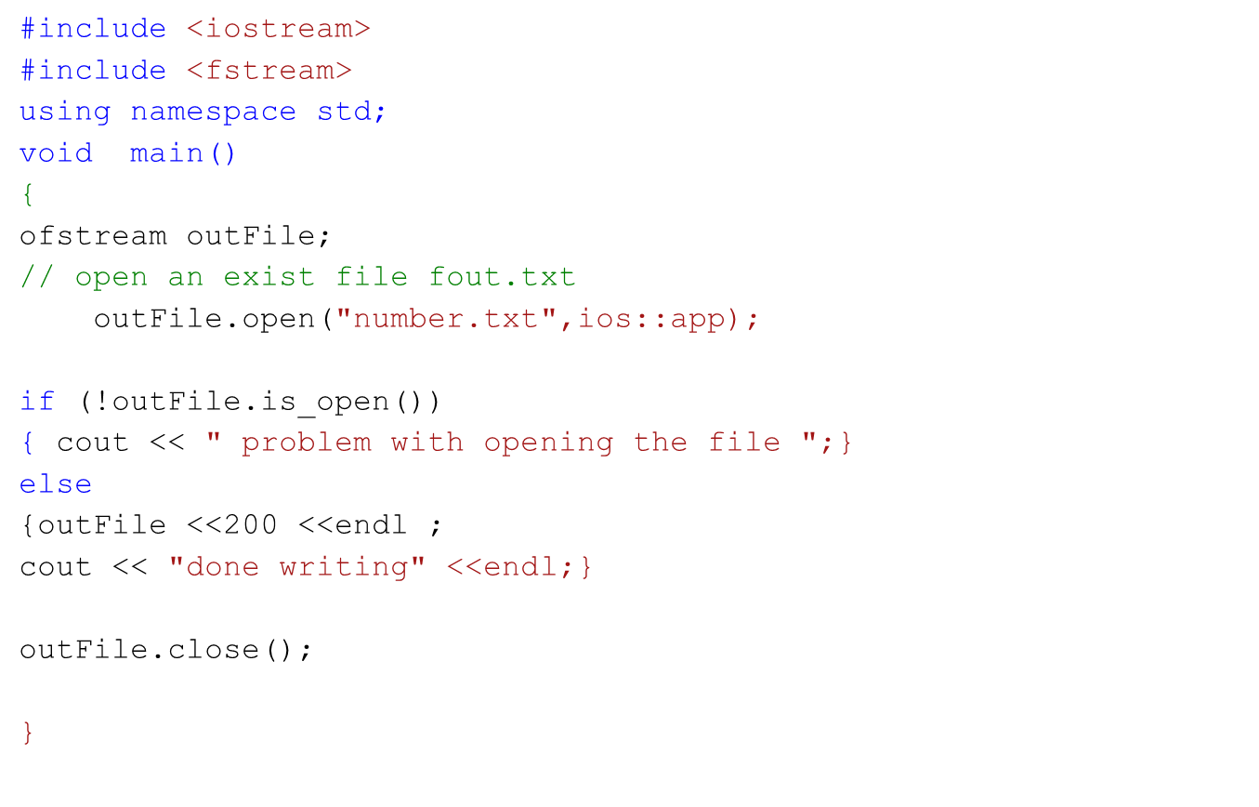
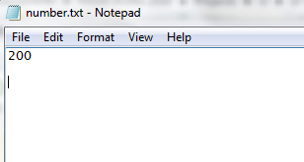
Example writing to file

Slide 19
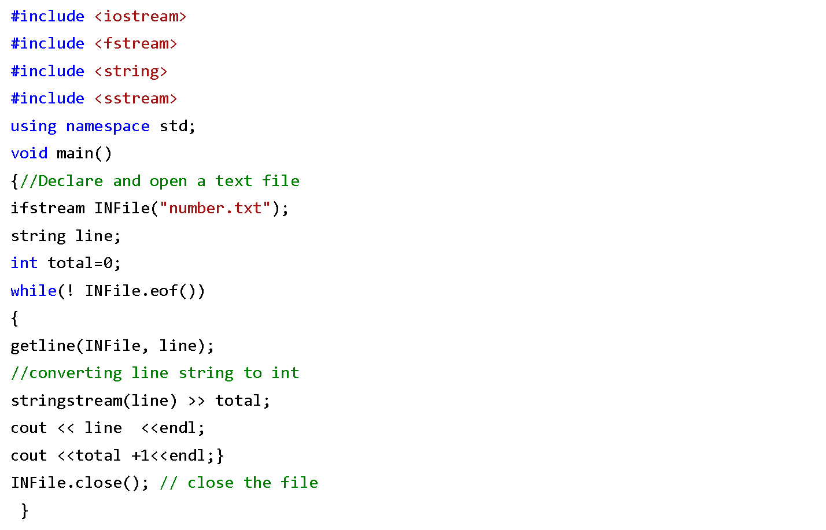
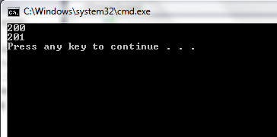
Example Reading from file

Slide 20
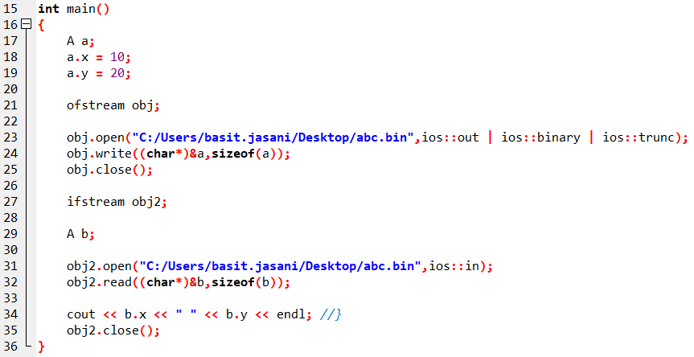
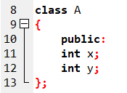
Writing OBJECTS to file

Slide 21
Errors!
In software industrial programming most of the programs contain bugs. Bigger the program greater number of bugs it contains.
The following are mainly errors or bugs that occurred in any program:
Logical error: In this error the logic implemented is incorrect. This error occurs due to less concentration of programmer or poor knowledge of programmer regarding program.
Compilation error: This error is occurred due to use of wrong idiom, function or structure. This error is shown at compilation time of program.
Run Time error: This error occurred at the run time. This error occurs when program crashes during run time..

Slide 22
Exception!
An exception is a situation, which occurred by the runtime error. In other words, an exception is a runtime error. An exception may result in loss of data or an abnormal execution of program.
It is a new feature that ANSI C++ included in it. Now almost all C++ compilers support this feature.

Slide 23
Exceptions!
Exceptions are different, however. You can't eliminate exceptional circumstances; you can only prepare for them. Your users will run out of memory from time to time, and the only question is what you will do. Your choices are limited to these:
Crash the program.
Inform the user and exit gracefully.
Inform the user and allow the user to try to recover and continue.
Take corrective action and continue without disturbing the user.

Slide 24
Exceptions!
Exception provides a method to control exceptional conditions (like run time error) or to control any crashed program by transferring control to some special functions called handler.
We can use following the keywords or functions to control runtime error in C++:
try {}
catch {}
throw()

Slide 25
try {} block
This block captures series of errors in any program at runtime and throw it to the catch block where user can customize the error message.
Syntax:
try
{
//define program;
throw(variable);
}

Slide 26
catch {} block
This block catches the error thrown by try block. This block contains method to customize error.
Syntax:
catch
{
//defines method to control error;
}

Slide 27
throw function
This function is used to transfer the error from try block to catch block. This function plays major role to save program from crashing.
Syntax:
throw(variable);

Slide 28
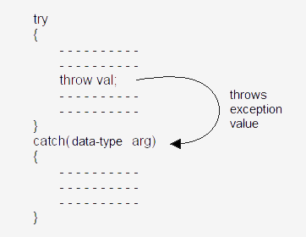
Exception Flow!

Slide 29
try-blocks and if-else
try-blocks are very similar to if-else statements
If everything is normal, the entire try-block is executed
else, if an exception is thrown, the catch-block is executed
A big difference between try-blocks and if-else statements is the try-block's ability to send a message to one of its branches

Slide 30
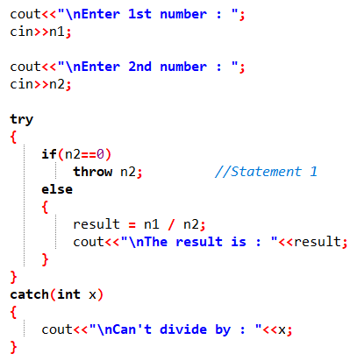
Example of simple try-throw-catch

Slide 31
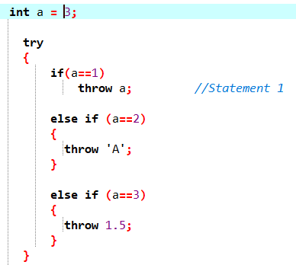
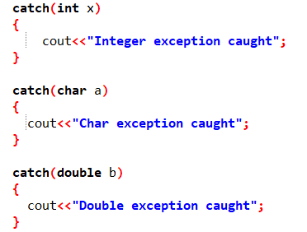
Multiple Catches

Slide 32
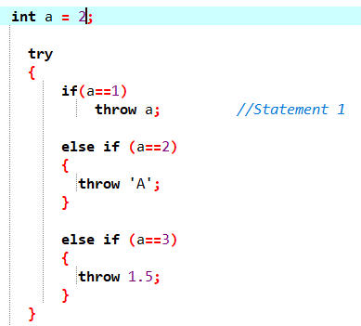
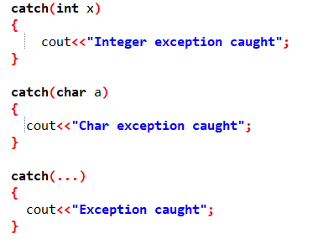
Catch all exceptions / Default Catch

Slide 33
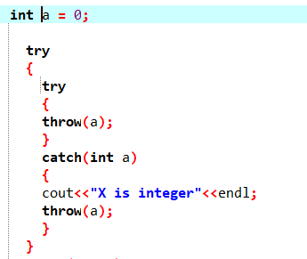
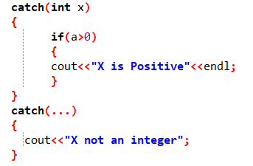
Nested Exception

Slide 34
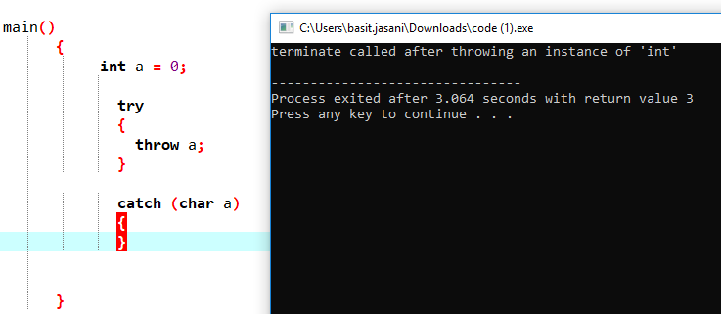
Exception not caught anywhere

Slide 35
Concept!
When an exception is thrown, all objects created inside the enclosing try block are destructed before the control is transferred to catch block.

Slide 36
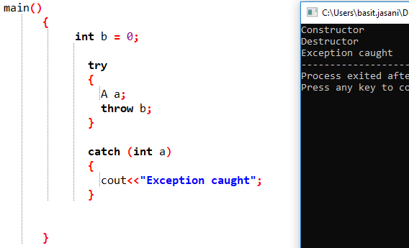
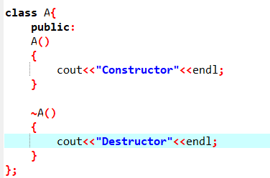
Example!

